Slide 1

Research Methods in Psychology: Asking Questions, Getting Answers
Notes:
So today I want to talk with you about how it is that we can do research of a
scientific kind for something as complex as human behavior as opposed to things
that you measure out in space or test tubes or under microscopes. People are
complex organisms, right? And to do research on them, to understand human
nature, how the mind works, how the brain supports it, is a challenging story.
So the usual thing is an experiment. You have a group of participants. And we'll talk
about that.
is Historically, in psychology there has been another
thread of the kind of way that people are studied, which is dramatic individual
stories, case studies, single stories that are illustrative of something that we think
are broader principles.
And a lot of our biggest discoveries-- and we'll come to that later in the course--
have been made on very unusual single individuals who turn out to have a lesson
that’s incredibly important.

Slide 2
The Lecture Topics
What is critical thinking?
Experimental and Non- Experimental Methods
Quantitative and Qualitative Research
Folk Psychology
Notes:
So I'm going to talk with you today about research in psychology. And a funny thing
about psychology, and I'll come back to this, is everybody is an amateur
psychologist. They have to be. If you deal with people, you're an amateur
Psychologist.
you hear all kinds of stuff, newspaper, internet,
magazines. Everywhere you go, friends will tell you stuff about psychologists have
found this or psychologists have found that. So you have your own intuitions to deal
with people in everyday life.
So today we’re going to talk a b bit about what makes up science, what makes an experiment, the beginnings of experimental psychology

Slide 3
What is research in psychology?
Why is it important?
How research shapes theories and practices.
Activity: Think-Pair-Share

Slide 4
What Is Critical Thinking?
(Brainstorming)

Slide 5
Components of critical thinking
Identifying and challenging assumptions is central to critical thinking
Challenging the importance of context is crucial to critical thinking
Critical thinkers try to imagine and explore alternatives
Imagining and exploring alternatives leads to reflective skepticism"
(from Developing critical thinkers, Stephen D. Brookfield, 1987)

Slide 6
Why Critical Thinking is important in Psychology?
Critical thinking is objective and requires you to analyse and evaluate information to form a sound judgement. It is a cornerstone of evidence-based arguments and forming an evidence-based argument is essential in Psychology.

Slide 7
What makes something scientific?
Ask any question | Why crow is black?
Form a Hypothesis | Crow is black because it lives outside and gets tanned
Try and test the Hypothesis (collection of data) | …………
Revise the Hypothesis (analyze of data)
Confirm/disconfirm hypothesis Summarize data and findings Modify theory

Slide 8
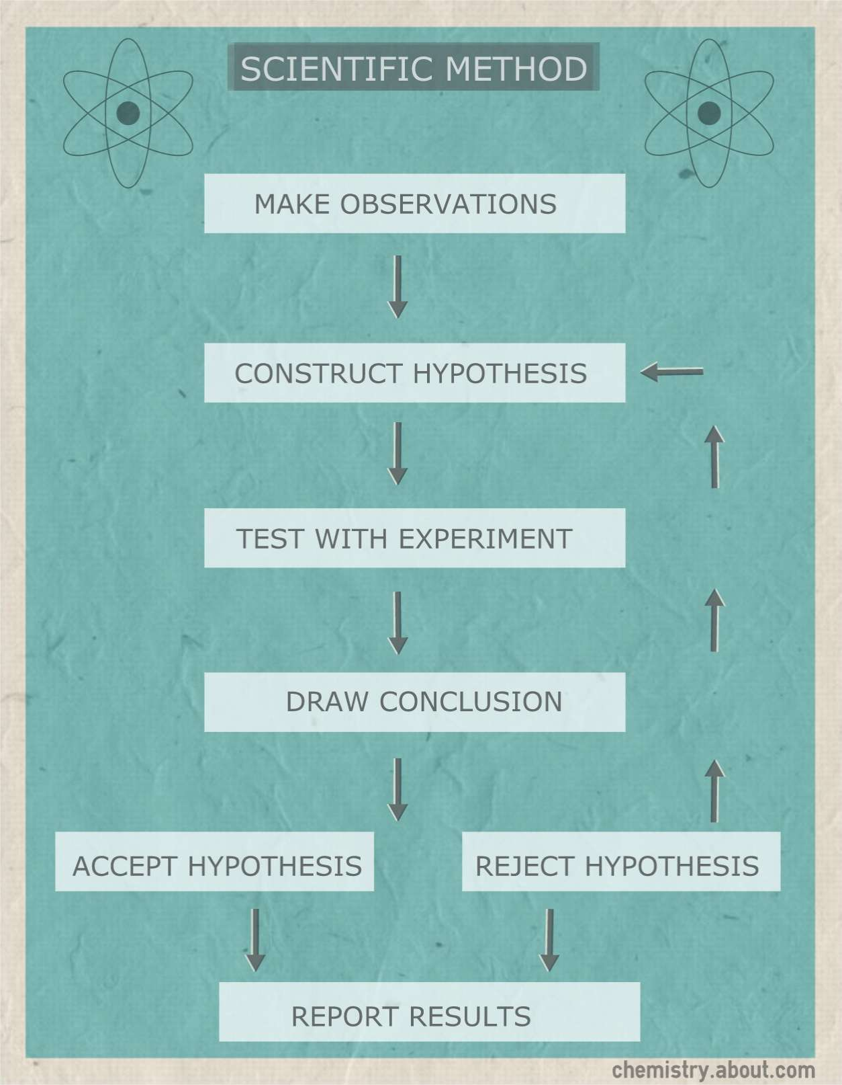
Steps in the Research Process
Identify a problem
Review literature
Formulate hypothesis
Choose a method
Collect data
Analyze results
Report findings

Slide 9
What makes something scientific?
The scientific method!
Falsifiable
Probabilities
Explanatory
Description
Correlational
Notes:
So you're used to hearing about the scientific method. It applies to psychology in
many ways just like it applies to chemistry, physics, or biology. We have to test
things that are falsifiable. We have to deal in probabilities of outcomes in terms of
statistics in some sense. The kinds of data we can have are descriptive or
correlative or experimental. I'll talk about those in a moment.

Slide 10
Types of Research
1. Causal or Experimental Research
2. Descriptive Research and Correlational Research
-Descriptive research does exactly what the name implies—it describes. This type of research seeks to show what already exists in a group or population.
- Correlational research, also known as correlational research, is a type of study that investigates the connection between two or more variables. These variables usually already exist in a population; the researchers just want to determine how they are related and the strength of that connection.

Slide 11
The first psychological experiment
Wilhelm Wundt (1832-1920)
Measuring how long it takes you to do things
Showed you a light. You press a button.
Takes about 1/5 of a second
Now, if the light turns on and it's red, you push one button. And if it's green, you push another.
So his idea was the motor system to push the button is about the same. The time to observe the light is about the same.
The choice is the difference. Turns out it’s about 1/10 of a second.
Notes:
So Wilhelm Wundt, big figure in psychology, first textbook in psychology, first
laboratory in psychology, did the following test of mental chronometry, simply
measuring how long it takes you to do things. So he would show you a light. And
you'd simply press the button. And that would take about 1/5 of a second.
And then he would say, instead, you do this. If the light turns on and it's red, you
push one button. And if it's green, you push another. So his idea was the motor
system to push the button is about the same. The time to observe the light is about
the same.
But the difference between these two is how long it takes to make a choice, how
long it takes to make a choice. And that difference, when he subtracts them, took
about 1/10 of a the second by that measurement. So all of sudden you could start to
measure, in an objective sense, how long a mental operation takes in your mind.

Slide 12
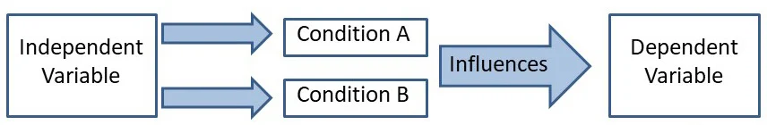
Causal or Experimental Research
What makes an experiment?

Slide 13
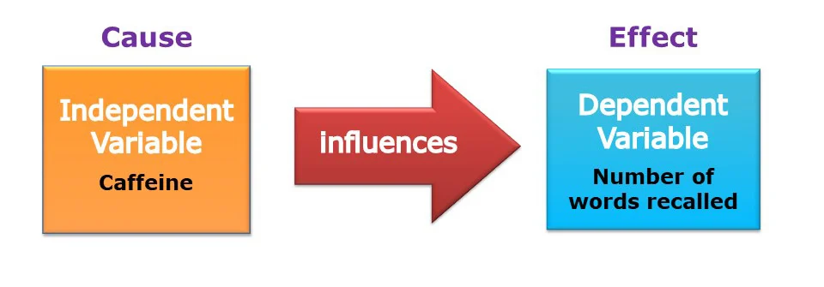
Causal or Experimental Research
Dependent variable
What you measure: the outcome
Independent variable
What you vary
Example?

Slide 14
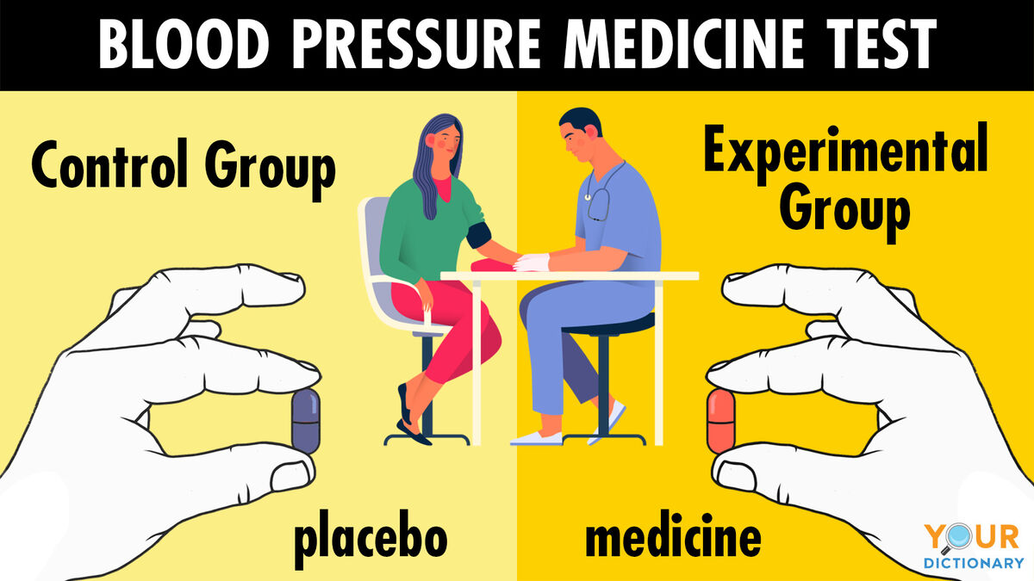
Causal or Experimental Research
Experimental Group receives the treatment or intervention being tested.
Control Group does not, serving as a baseline for comparison.

Slide 15
Non-experimental research does not involve the manipulation of variables.
The aim of this research type is to explore the factors as they naturally occur.
This method is used when experimentation is not possible because of ethical or practical reasons.
Instead of creating a sample or participant group, the existing groups or natural thresholds are used during the research.
This research method is not about finding causality between two variables.
Most studies are done on past events or historical occurrences to make sense of specific research questions.

Slide 16
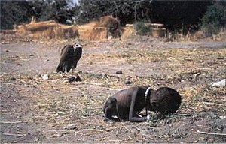

Slide 17


Slide 18
Descriptive Research and Correlational Research
Case studies
Observational studies
Correlational
Longitudinal
Quasi experimental
Cross sectional Observational
(Group activity)

Slide 19
What are some issues with psychological experiments?

Slide 20
What are some issues with psychological experiments?
Experimental population (who is in your experiment)
Experimenter bias/demand characteristics
Experimenter effects/confirmation bias
Little things can affect behavior!

Slide 21
Quantitative and Qualitative Research

Slide 22
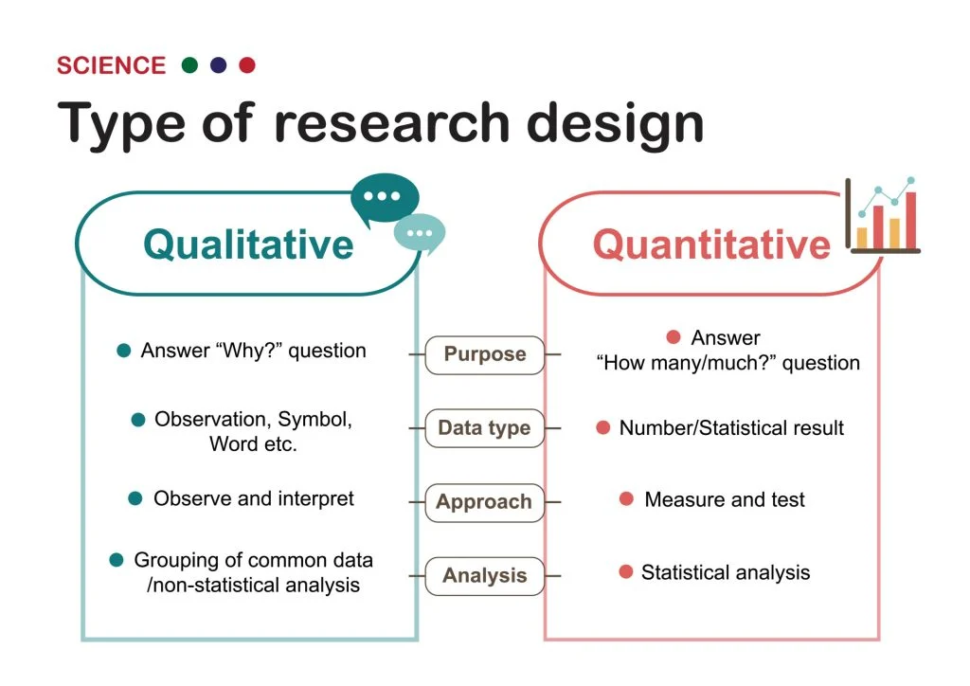

Slide 23
Quantitative Research
Quantitative research involves the process of objectively collecting and analyzing numerical data to describe, predict, or control variables of interest.
The goals of quantitative research are to test causal relationships between variables, make predictions, and generalize results to wider populations.
Quantitative researchers aim to establish general laws of behavior and phenomenon across different settings/contexts. Research is used to test a theory and ultimately support or reject it.

Slide 24
Data Collection Method
Quantitative studies, in contrast, require different data collection methods. These methods include compiling numerical data to test causal relationships among variables. Some forms of data collection for this type of study include
Experiments
Questionnaires
Surveys
Database reports
Interview
The above collection methods yield data that lends itself to numerical analysis. Questionnaires in this case have a multiple-choice format to generate countable answers, such as “yes” or “no,” which can be turned into quantifiable data.

Slide 25
Types of Quantitative Research
Descriptive
Correlation
Causal-comparative/ quasi-experimental research
Laboratory Research

Slide 26
Qualitative Research
Qualitative research is a field of enquiry that is employed to explore and understand people’s belief, attitude, experience, behavior and interaction. It helps to gain the in-depth understanding of human behavior.

Slide 27
Data collection methods
Focus group discussion
Participant observation
In-depth interview
Document and material analysis
Direct observation

Slide 28
Types of Qualitative Research
Ethnographic
Ethical Inquiry
Historical Research
Phenomenology
Philosophical
Case study

Slide 29
Folk Psychology & Scientific Psychology
everybody has ideas about how they think and behave and how other people think and behave
scientific psychology sometimes supports and sometimes contradicts these ideas

Slide 30
Ideas About People & Psychology
Opposites attract, on average
Familiarity breeds contempt, on average
The more people present at an emergency, the more likely that someone will intervene
There are visual learners and there are verbal learners
Hypnosis is nonsense
Subliminal advertising works
Playing Mozart’s music to infants boosts their intelligence
Old age, on average, is associated with dissatisfaction
If you are unsure of your answer when taking a test, it’s best to stick with your initial hunch
Ulcers are caused primarily by stress
A positive attitude can stave off cancer
Raising children similarly leads to similarities in their adult personalities
Low self esteem is a major cause of psychological problems
People’s responses to Inkblot tests tells us a great deal about their personalities
Interviews help identify those most likely to succeed in medical school.
Yes
No
Yes
No
Yes
No

Slide 31
Ideas About People & Psychology
Opposites attract, on average NO
Familiarity breeds contempt, on average NO
The more people present at an emergency, the more likely that someone will intervene NO
There are visual learners and there are verbal learners NO
Hypnosis is nonsense NO
Subliminal advertising works NO
Playing Mozart’s music to infants boosts their intelligence NO
Old age, on average, is associated with dissatisfaction NO
If you are unsure of your answer when taking a test, it’s best to stick with your initial hunch NO
Ulcers are caused primarily by stress NO
A positive attitude can stave off cancer NO
Raising children similarly leads to similarities in their adult personalities NO
Low self esteem is a major cause of psychological problems NO
People’s responses to Inkblot tests tells us a great deal about their personalities NO
Interviews help identify those most likely to succed in medical school. NO
Yes
No
Yes
No
Yes
No

Slide 32
Ideas About People & Psychology
No No
No No No No No No
These were all statements that come from the Western World. Can we think of a few that are from our part of the world?
No No No
No
No
No

Slide 33
Thank you!

